Slide 1
Lending Club Case Study
Student Name : Prachi Satish Sonavane

Slide 2
Introduction
The lending club case study is for analysing the loan dataset for an insight for decision making in loan lending company.
In this case study, Exploratory Data Analysis is applied to analyse the data for business driven decision making
Required methods like Univariate and Bivariate analysis etc done on the dataset and represented with different types of plots to get the best analysis results from the dataset
We can use this analysis for business driven decision making for lending loan to customers to reduce/avoid loss and make most of the profit to the company

Slide 3
Getting into analysis
You can find different types on analysis done in this dataset to understand it better along with plots for better readability and understanding of the data.

Slide 4
Data cleaning
In the beginning of the file of python code, you will see below :
Missing values are handled
30% threshold is applied to handle columns with NA values
Dropping unnecessary columns from dataset
Outlier treatment applied on Loan amount column
Defined a custom function to calculate default rate
Univariate and Bivariate analysis applied for further analysis on the dataset as explained in next slides

Slide 5
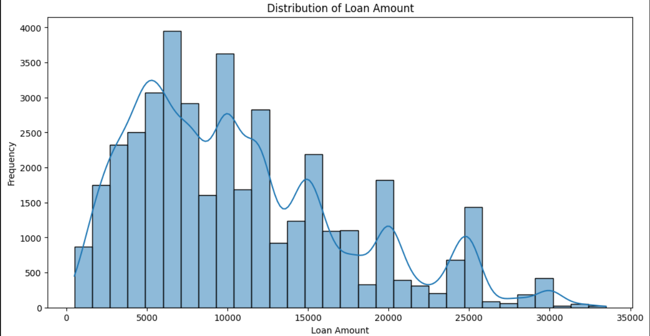
Identifying potential loan defaults
Univariate analysis is applied for identifying potential of loan default to reduce credit losses

Slide 6
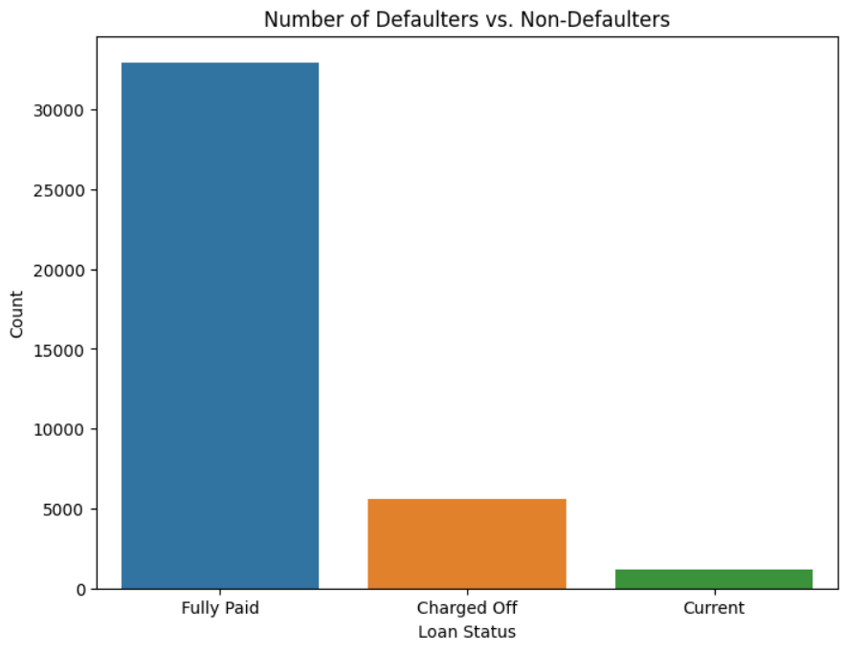
Defaulters vs non-defaulters
Plotting number of defaulters vs non-defaulters
This can help understand if loan lending to customers is being done correctly and business is in loss or profit
Here, we can see, most of the loans are fully paid indicating not much loss and profit of the company

Slide 7
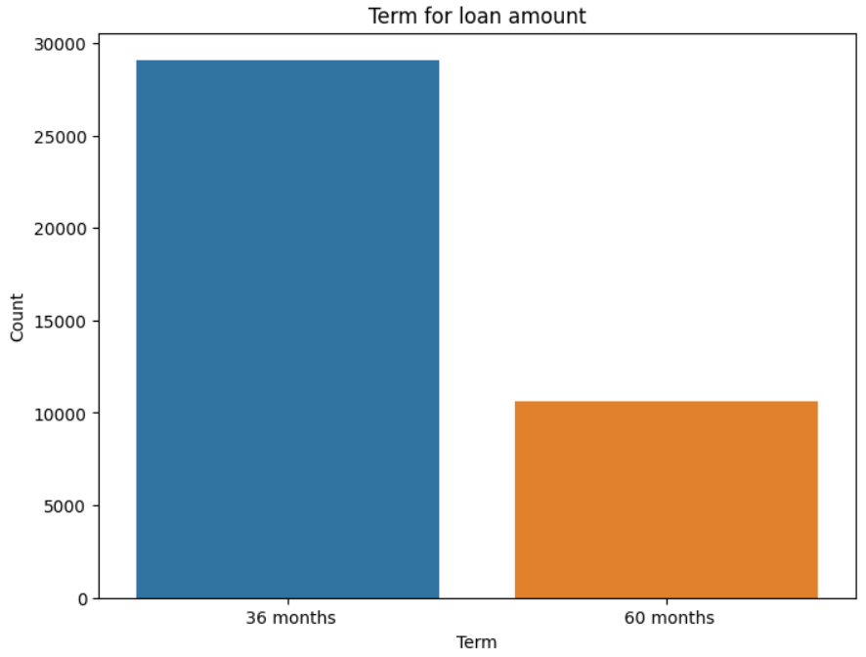
Loan term
Plotting how many customers take loan for what term.
This can help understand customers prefer loan with longer term or shorter term

Slide 8
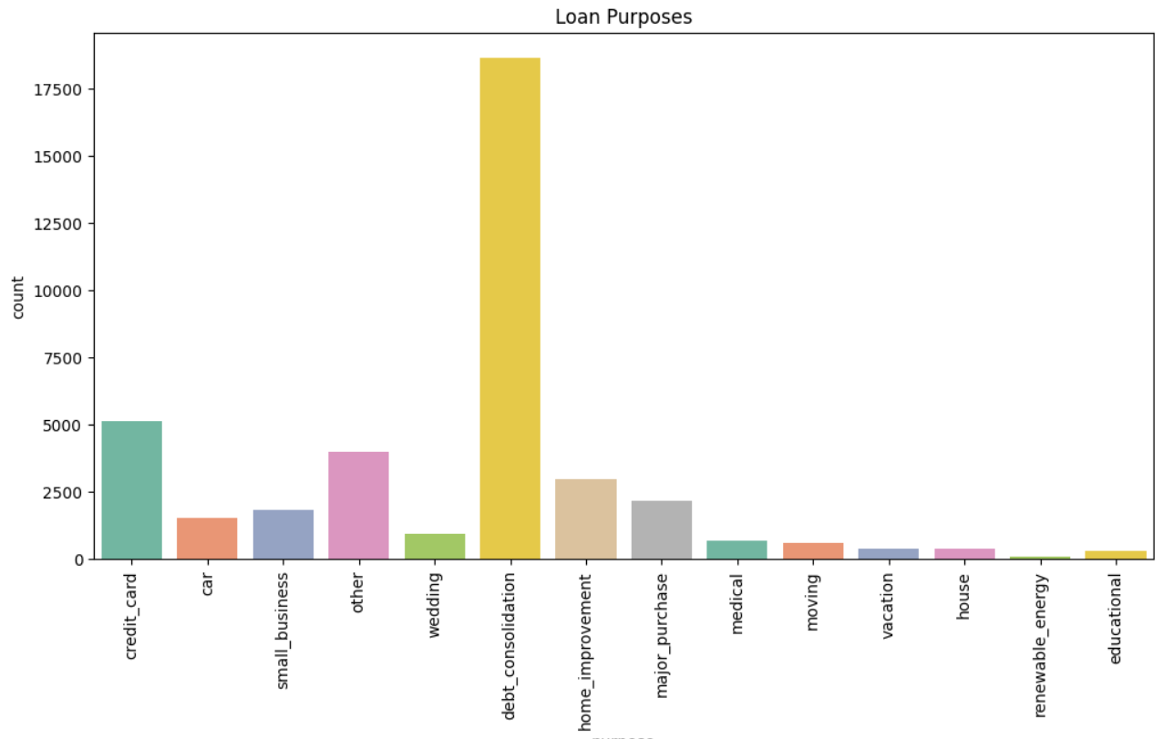
Loan purposes
Analysing here purposes for which customers have taken loan
Here, we can see most of the loans are taken for debt consolidation and second most for credit card
We can use this analysis for targeting and approaching customers for offering loan accordingly

Slide 9
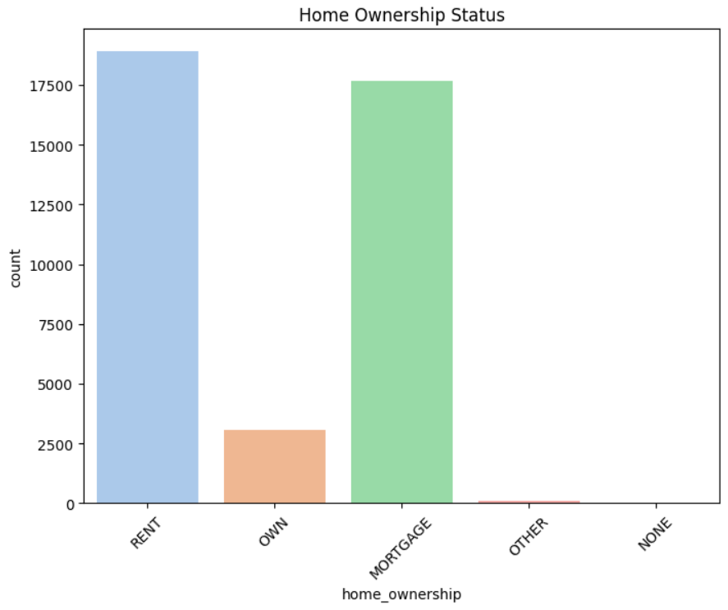
Home ownership
This shows ownership type of home of the customers
We can see most of the customer’s home type is either rent or mortgage

Slide 10
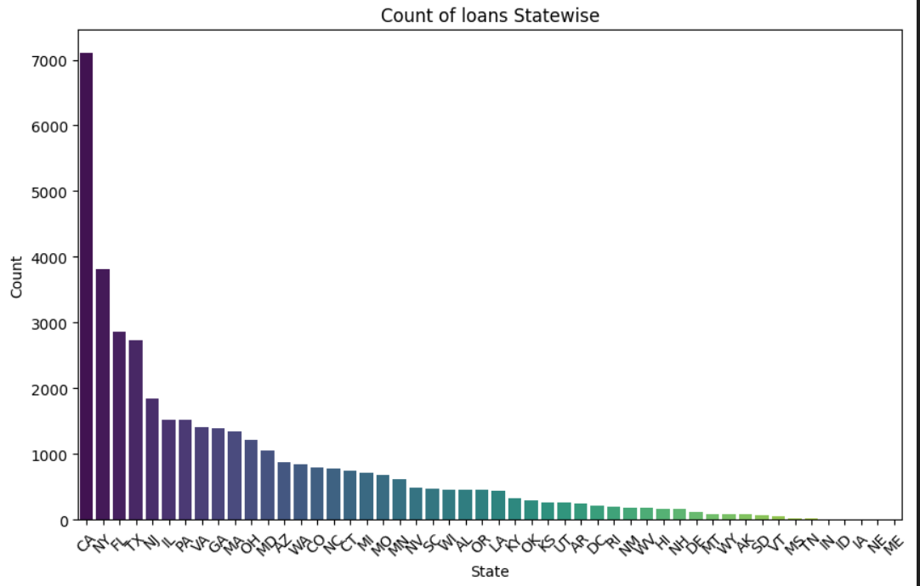
Count of loans state wise
State wise analysis of loans
Here, we can see most of the loans are taken by customers in CA and then followed by other states like NY, FL, TX, NJ etc
Using this analysis, we can target the customers state wise to for offering loans

Slide 11
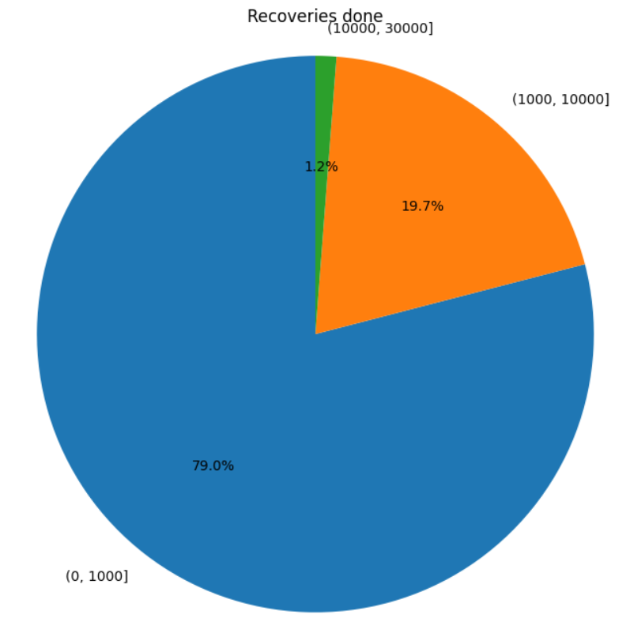
Recoveries done
This shows that most of the recoveries done are done

Slide 12
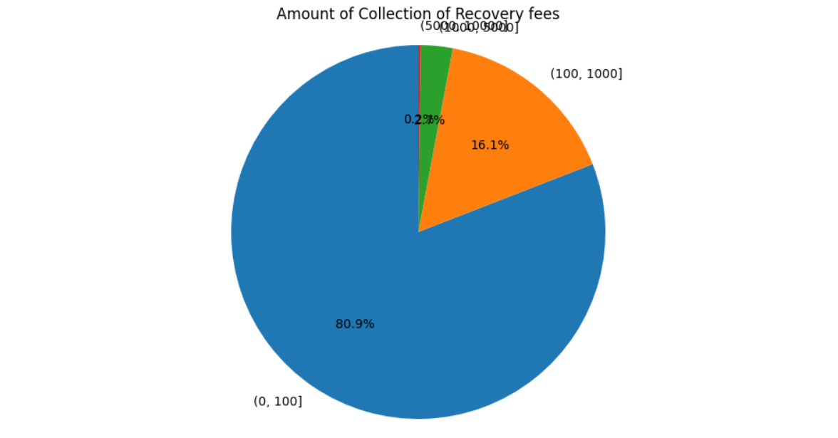
Amount of recovery fees
This shows recoveries amount and the amount of most of the recoveries done is between 0 to 100

Slide 13
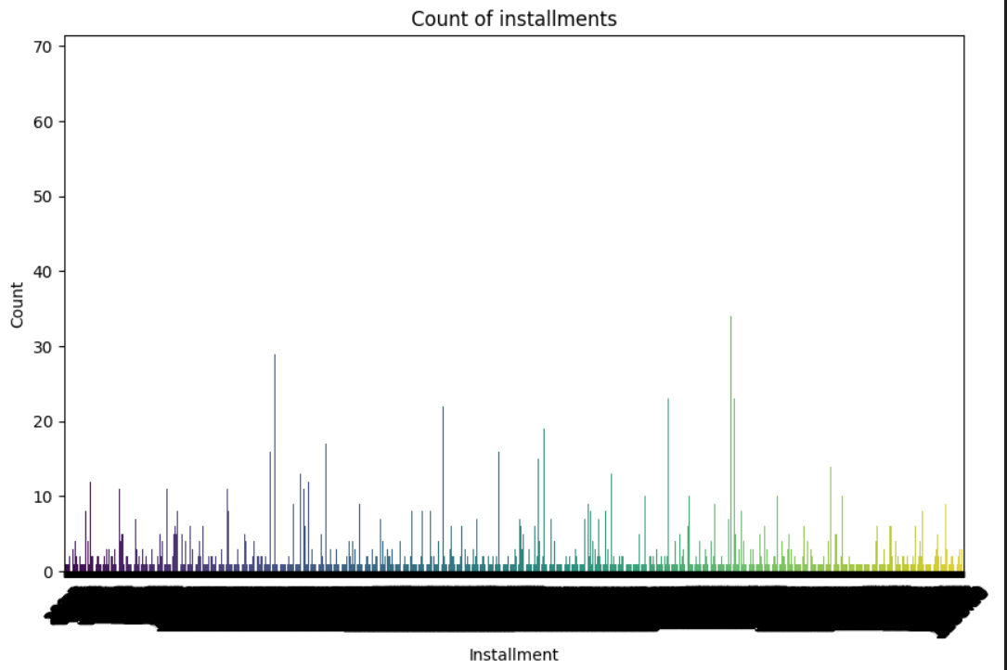
Count of instalments
This shows count of large amount instalments is less as compared to count of smaller amount istalments

Slide 14
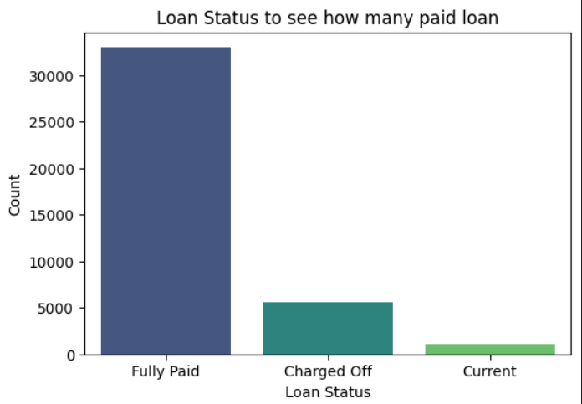
Loan status
This show loan status that how many are paid fully, how many charged off and how many are current

Slide 15
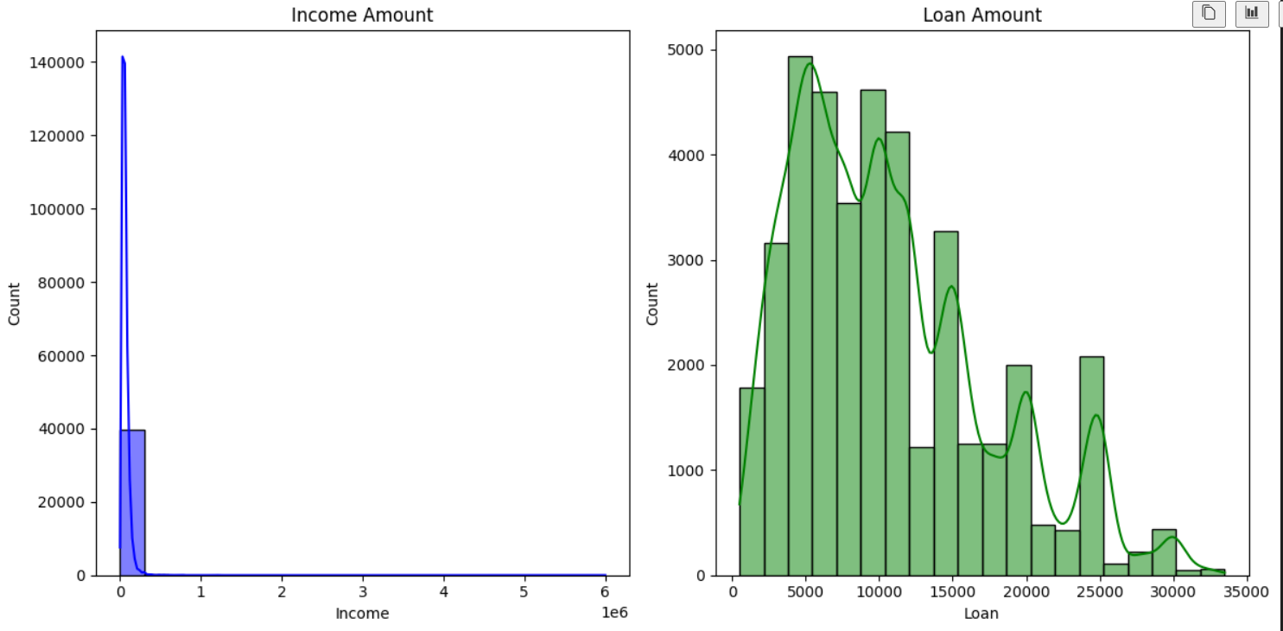
Income vs loan amount
This analysis shows income vs loan amount

Slide 16
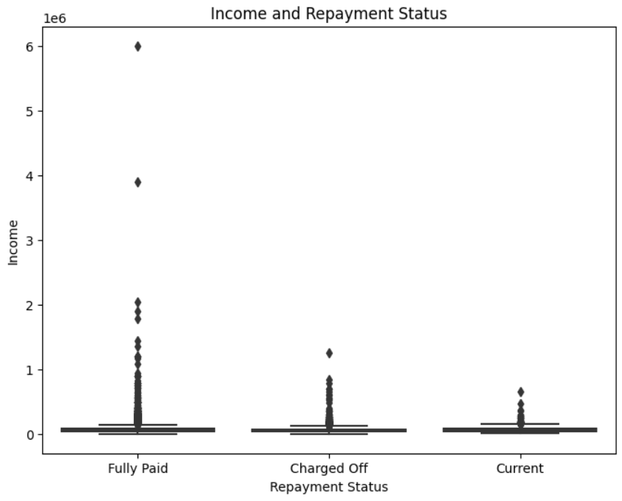
Income and repayment status
This shows income and repayment status of the loans

Slide 17
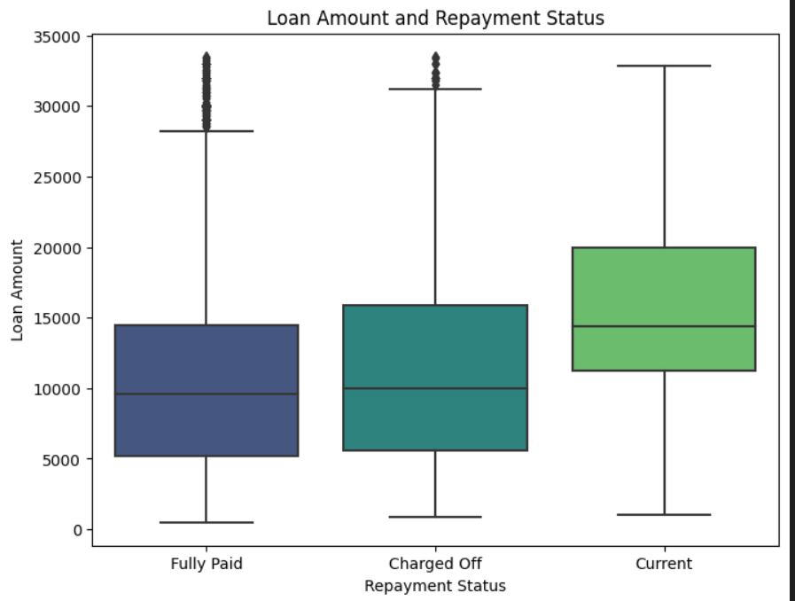
Loan amount vs repayment status
This shows loan amount and repayment status of the loans

Slide 18
Analysis and conclusion
Referring to our analysis done above on the given loan dataset, we have seen many factors that can help to target customers to pitch for offering them loans to get more customers with more profit and less risk component.
We can consider different factors for this like which state’s customers most likely too take loans and pay back fully, income of customers and purpose of their loan and so on as mentioned above.
With this analysis, we can reduce the risk factor and increase profit for this loan lending company.

Slide 19
Thank you !
Prachi Satish Sonavane

